Slide 1
Welcome to Marketing Management
Dr. Cecilia Ruvalcaba
BUSI 107 Week 4, Day 3

Slide 2
Chapter 6: Consumer behavior cont…

Slide 3
Customer Buying Process
Buyer’s mental evaluation of alternatives
Recognition of problem or need
Search for alternatives and info.
Purchase
Post purchase behavior
Influencing Factors
Depleted inventory
Advertising
Promotions
Store display
Past experience
Brochures
Catalogs
Internet
Friends
Social class
Personality
Lifestyle
Restaurant
Store location
Menu
Availability of credit
Speed of repairs
Product Quality
Extended warranty
Time Line

Slide 4
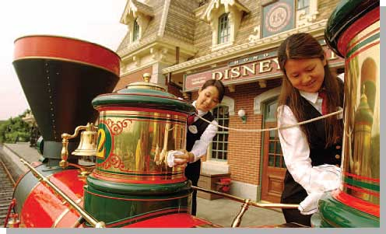
Create and deliver “Customer Value” - road to “customer satisfaction
The relationship between benefits and the sacrifice necessary to obtain those benefits.

Slide 5
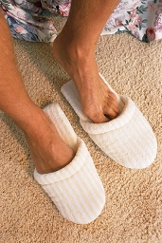
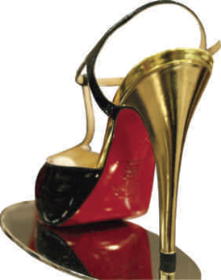
Need Recognition
Objective: Build top-of-mind awareness
Internal
Stimuli
Preferred State
Present
Status
External
Stimuli
Marketing helps consumers recognize an imbalance between present status and preferred state.
Functional & Psychological

Slide 6
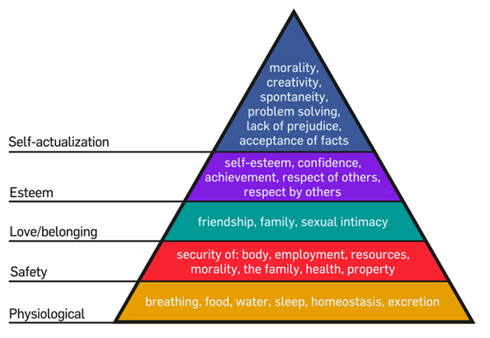
Motivating by Meeting Needs

Slide 7
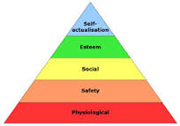
Key Points of Maslow
How needs are satisfied.
Lower order needs: externally.
Higher order needs: internally.
How they motivate.
Deficiency: if not met, won’t become healthy person.
Growth: if met, person reaches full potential.
When each need becomes satisfied, we move up the hierarchy and the next need becomes dominant.

Slide 8
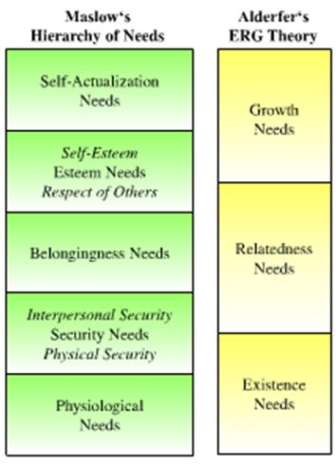
An Adjustment of Maslow’s Hierarchy- Alderfer’s ERG Theory
Three groups of core needs:
Existence needs
Desires for physiological and material well-being.
Relatedness needs
Desires for satisfying interpersonal relationships.
Growth needs
Desires for continued personal growth and development.
Research results on theory mixed.

Slide 9
Information Search
Internal Information Search
Recall information in memory
External Information search
Seek information in outside environment
Nonmarketing controlled
Marketing controlled
How Much Information Search? Benefits vs. Cost
What are the risks?
(Performance, Financial, Social, Physiological, Psychological)
Objective: Communicate products/services and differentiation.

Slide 10
Evaluation of Alternatives and Purchase
Objective: Be found when consumer makes final purchase decision.
Evoked Set
Analyze Product Attributes
(Evaluative Criteria)
Use cutoff criteria
(Determinant Attributes)
Rank attributes by
importance
Purchase!

Slide 11
Post-purchase Behavior
Objective: Communicate incentives, reassure, create brand advocates.
Consumers can reduce dissonance by:
Seeking information that reinforces positive ideas about the purchase
Avoiding information that contradicts the purchase decision
Revoking the original decision by returning the product
Marketing can minimize through:
Effective Communication
Follow-up
Guarantees Warranties

Slide 12


Take Away for Today
Be a Value Builder: Find a way to build value for your customers (beyond price)
The Customer Buying Process
Connect with customers by finding your fit in each part of the process!

Slide 13

Next Class
Chapter 7: STP
Wednesday February 22.
Library Database Session w/ Jack Schroeder
Exam 1: Monday February 20th

